Slide 1

Computer Networks
Introduction to data communication & Computer networks
Lecture # 02

Slide 2
Services
Internet is an infrastructure that provides services to applications
Examples:
electronic mail, Web surfing, social networks, instant messaging, Voiceover-IP (VoIP), video streaming, distributed games, peer-to-peer (P2P) file sharing, television over the Internet, remote login, and much, much more.
Called distributed applications, since they involve multiple end systems that exchange data with each other.
Applications run on the end systems and not on the switches.
Application Programming Interface APIs

Slide 3
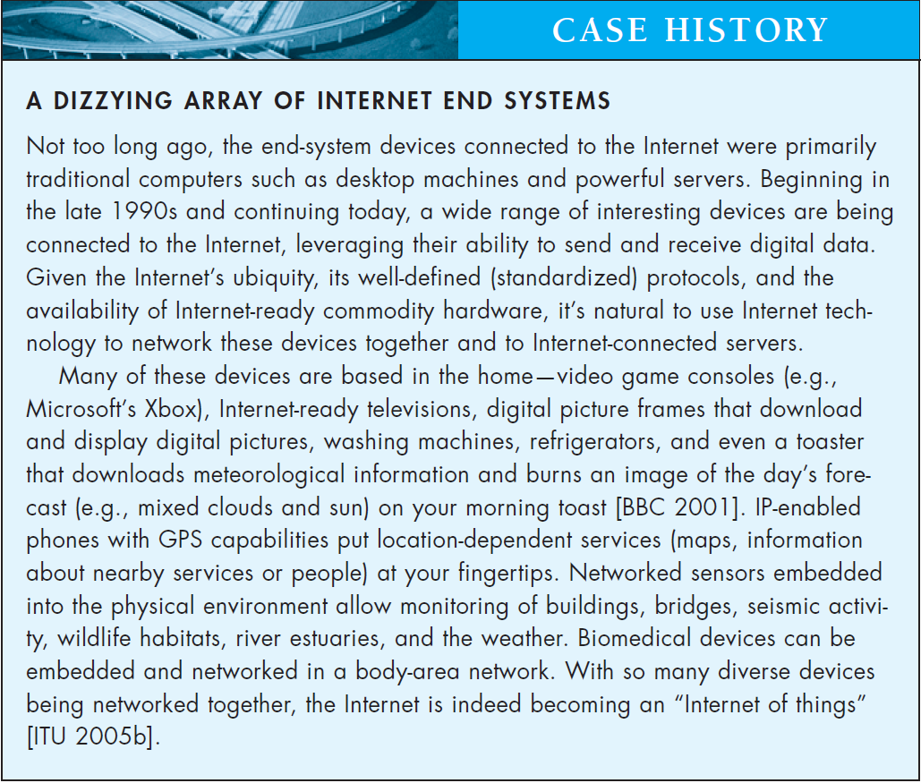

Slide 4
Network Edge
Hosts/ End Nodes
Client-Servers/ Peers
Access Network
the network that physically connects an end system to the first router (also known as the “edge router”) on a path from the end system to any other distant end system.
Notes:
Most common Home networks are DSL Digital Subscriber line and cable.
On corporate and university campuses, and increasingly in home settings, a local area
network (LAN) is used to connect an end system to the edge router. Although there
are many types of LAN technologies, Ethernet is by far the most prevalent access
technology in corporate, university, and home networks.

Slide 5
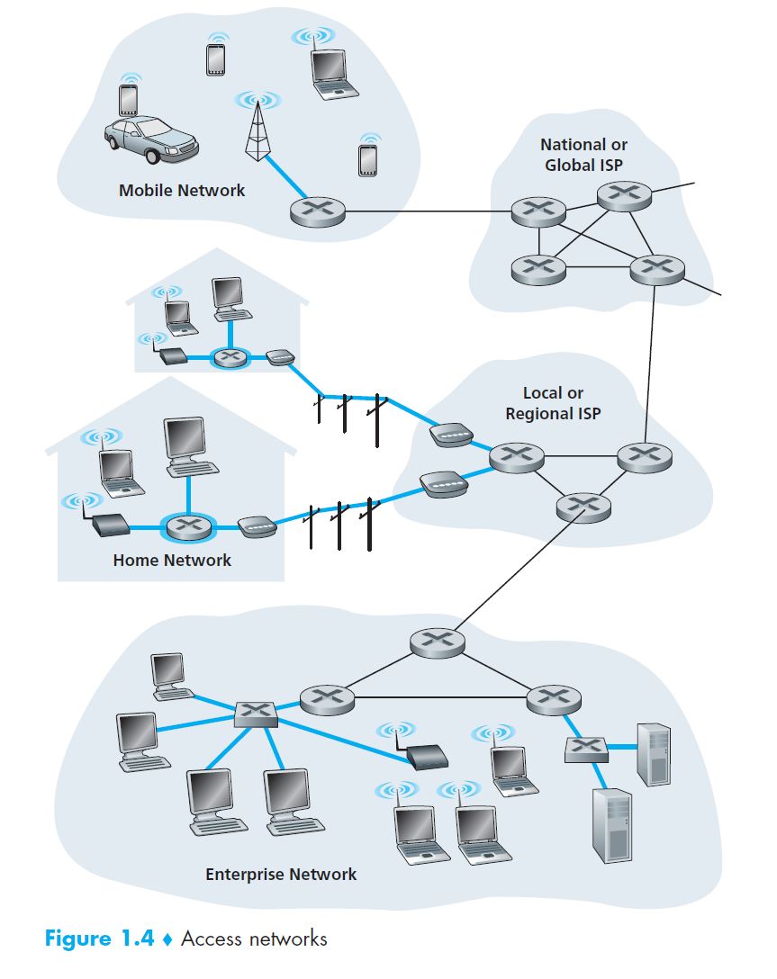
Notes:
LAN, WAN

Slide 6
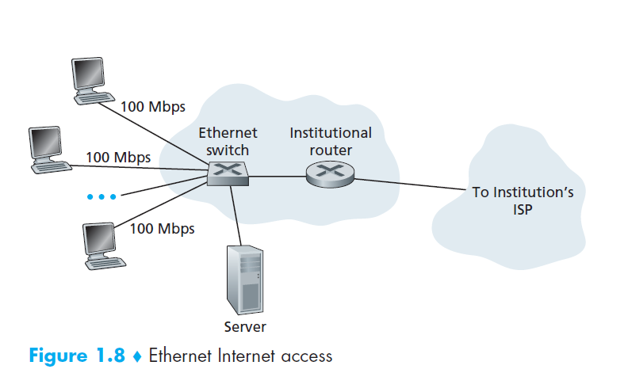

Slide 7
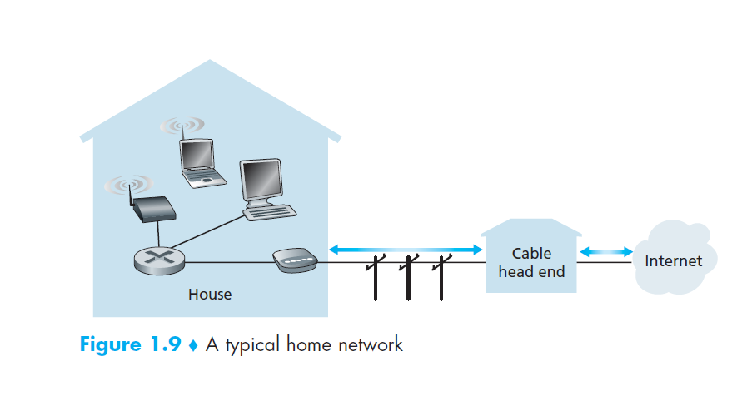

Slide 8
Wide-Area Wireless Access
Mobile Networks
3G, 4G, 5G, LTE
Notes:
LTE ( for “Long-Term Evolution”—a candidate for Bad
Acronym of the Year Award) has its roots in 3G technology, and can potentially
achieve rates in excess of 10 Mbps. LTE

Slide 9
Types of Communication or Connections Directions of Data Flow
Communication modes could be:
Simplex
One Way (Uni directional) only
One device is sender and other is receiver
Monitor, Speakers, Bluetooth devices etc
Is Keyboard Simplex?
Half Duplex
Bi-directional
Only One device can send at a time and other will receive
Traditional Wireless Sets
Full Duplex
Bi-Directional
Both Devices can send/Receive simultaneously
Telephone Network
Notes:
Bluetooth devices

Slide 10
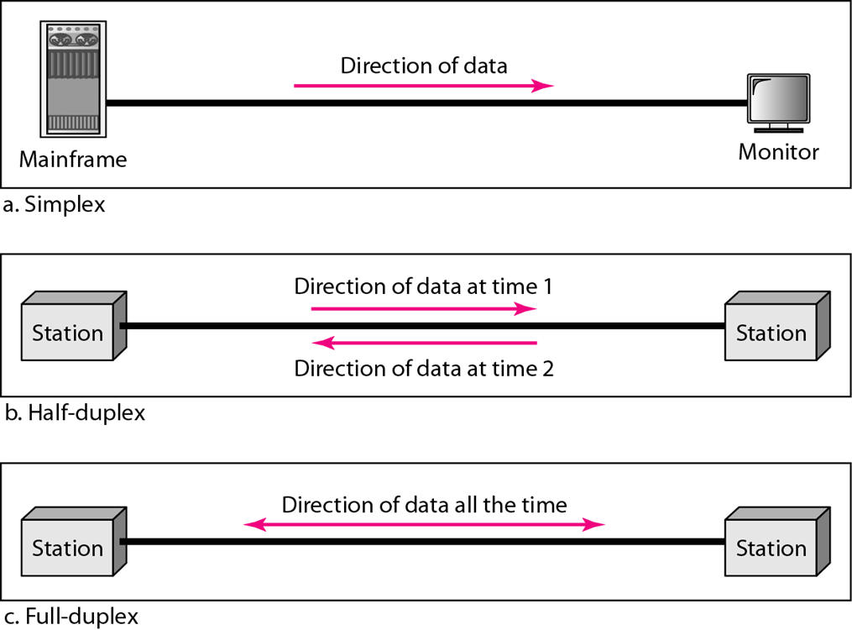

Slide 11
Networks
A network is a set of devices (often referred to as nodes) connected by communication links.
A node can be a computer, printer, or any other device capable of sending and/or receiving data generated by other nodes on the network.
A link can be a cable, air, optical fiber, or any medium which can transport a signal carrying information.
Network Criteria
Physical Structures
Categories of Networks
Notes:
Node= end users
Link= communication media

Slide 12

Network Criteria
Performance
Depends on Network Elements
Measured in terms of Delay and Throughput
Reliability
Failure rate of network components
Measured in terms of availability/robustness
Security
Data protection against corruption/loss of data due to:
Errors
Malicious users

Slide 13
Physical Structure
Type of Connection
Point to Point -single transmitter and receiver
Multipoint -multiple recipients of single transmission
Physical Topology
Connection of devices
Type of transmission -unicast, mulitcast, broadcast
Notes:
https://www.geeksforgeeks.org/difference-between-unicast-broadcast-and-multicast-in-computer-network/

Slide 14

Physical Topology
Topology dictates that how nodes are physically connected in a network
Geometric representation of relationship of all the links and linking devices
Four basic topologies:
Mesh
Star
Bus
Ring

Slide 15
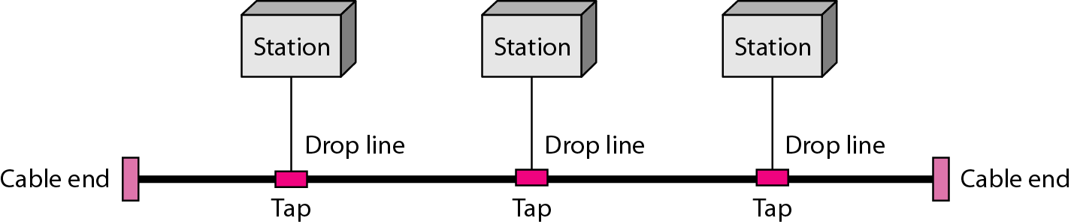
Topology: Bus
A Bus Topology connecting three stations

Slide 16
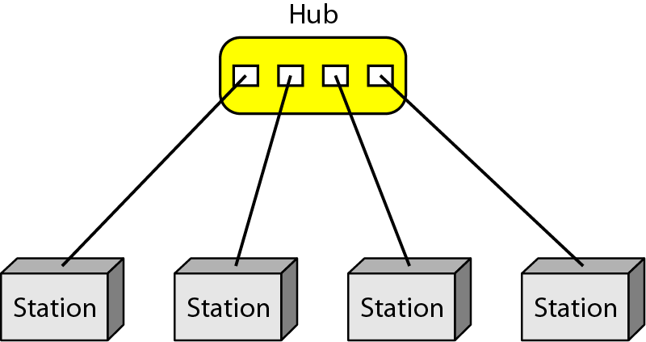
Topology: Star
A star topology connecting four stations through a central device (hub)

Slide 17
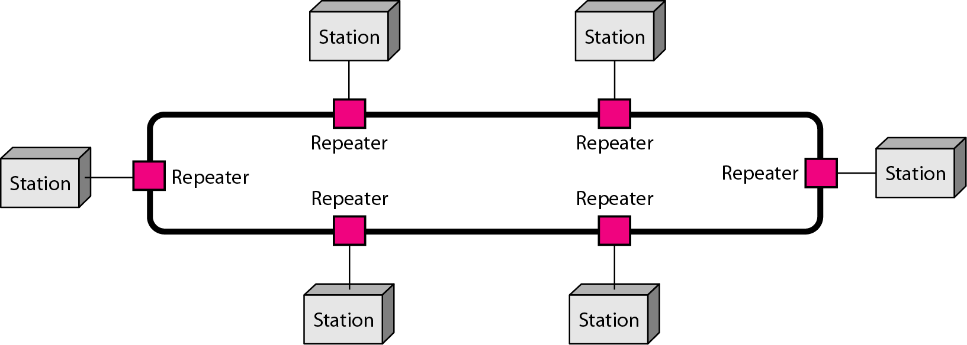
Topology: Ring
A Ring Topology connecting six stations

Slide 18
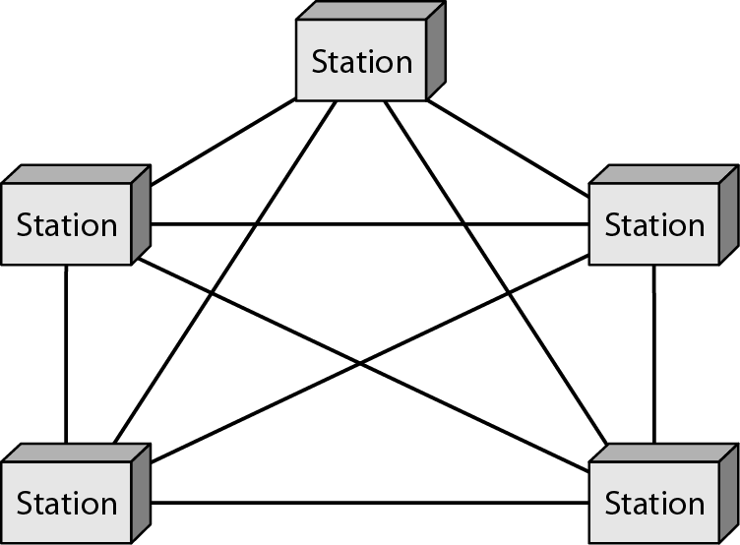
Topology: Fully Connected Mesh
All the stations have a P-to-P link with all other stations in the network

Slide 20
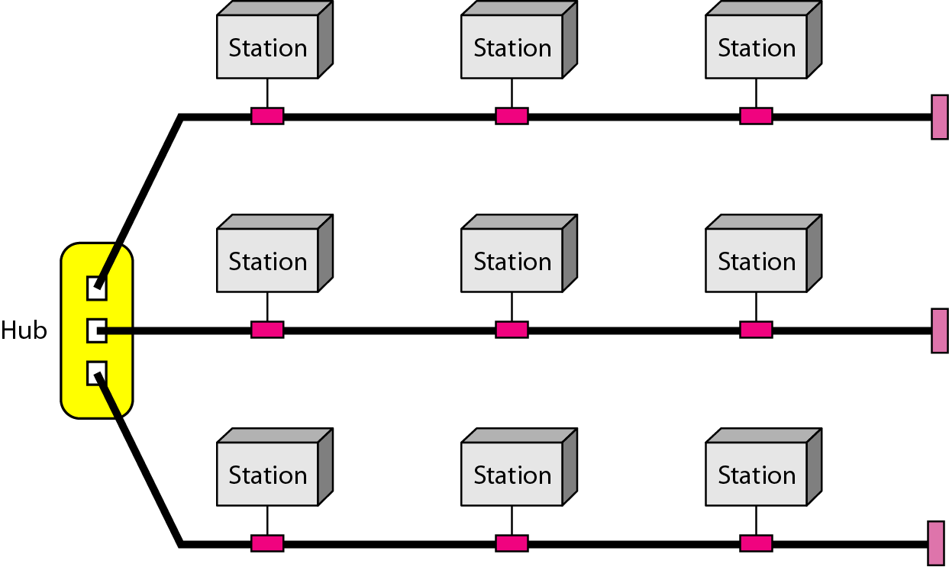
Hybrid Topology
Topology that is constituted by integrating more than one topology

Slide 21
Types of Networks
Client Server Networks
Peer To Peer Networks

Slide 22
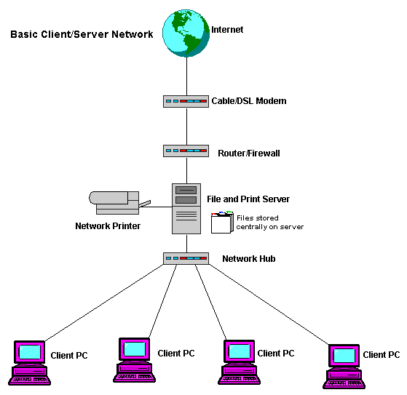
Client Server Implementation

Slide 23
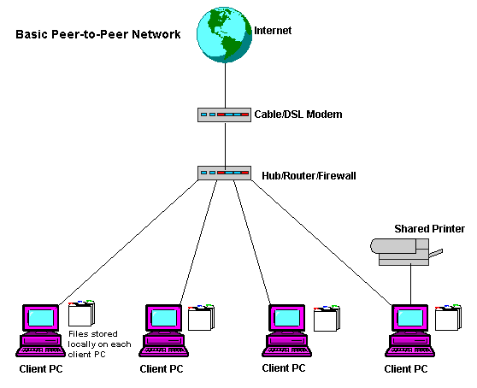
Peer-to-Peer Networks

Slide 24
Reading Assignment
Discuss Client/Server and Peer-to-Peer networks with examples. State usage, advantages, disadvantages of each.
Some types of networks have been discussed like LAN and WAN. You are required to learn about other network configurations including:
WAN (Wide Area Network)
LAN (Local Area Network)
WLAN (Wireless Local Area Network)
MAN (Metropolitan Area Network)
SAN (Storage Area Network)
CAN (Campus/Controlled/Cluster Area Network)
PAN (Personal Area Network)
Note: All reading assignments are part of exam
Notes:
Wlan:A WLAN typically extends an existing wired local area network. WLANs are built by attaching a device called the access point (AP) to the edge of the wired network. Clients communicate with the AP using a wireless network adapter similar in function to a traditional Ethernet adapter.
A WLAN allows users to move around the coverage area, often a home or small office, while maintaining a network connection.
SANA storage area network (SAN) is any high-performance network whose primary purpose is to enable storage devices to communicate with computer systems and with each other

Slide 25
Network Model
A network is a combination of hardware and software that sends data from one location to another.
The hardware consists of the physical equipment that carries signals from one point of the network to another.
The software consists of instruction sets that make possible the services that we expect from a network.

Slide 26
Network Models
OSI Model(Open Systems Interconnection) :
7 Layers
Ideal model
provide reference to guide vendors and developers.
TCP/IP Model (Transmission Control Protocol/ Internet Protocol)
4 Layers, 5 Layer
Implemented in most internet standards
Older than OSI Model
TCP/ IP protocol suite

Slide 27
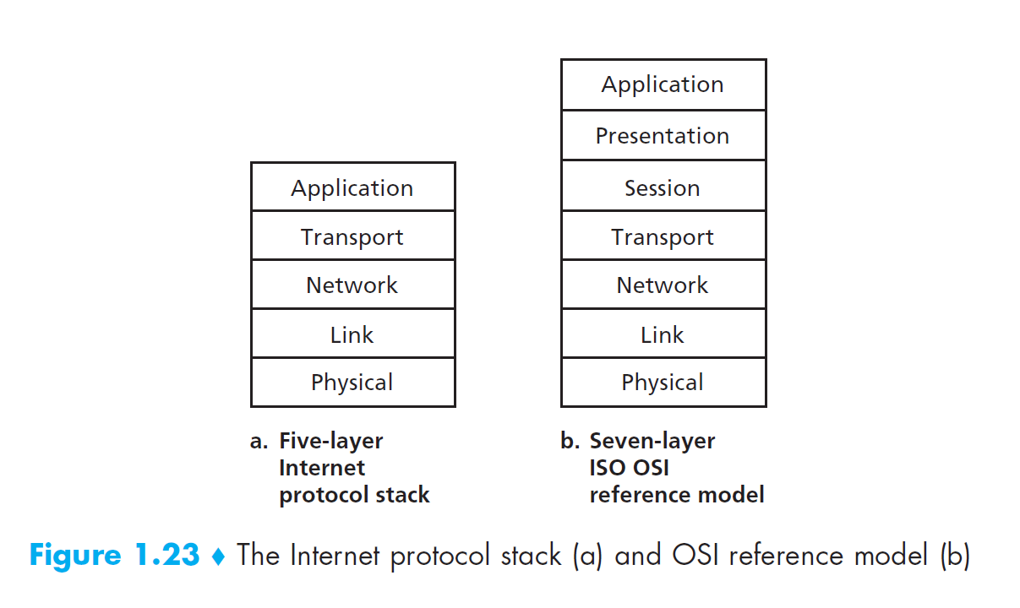

Slide 28
Layered Tasks
Notes:
We use the concept of layers in our daily life. As an example, let us consider two
friends who communicate through postal maiL The process of sending a letter to a
friend would be complex if there were no services available from the post office

Slide 29
OSI Model
In1970s, the International Standards Organization (ISO) introduced an ISO standard Open Systems Interconnection OSI model.
An open system is a set of protocols that allows any two different systems to communicate regardless of their underlying architecture.
The purpose of the OSI model is to show how to facilitate communication between different systems without requiring changes to the logic of the underlying hardware and software.
The OSI model is not a protocol; it is a model for understanding and designing a network architecture that is flexible, robust, and interoperable.

Slide 30
Layered framework for the design of network systems that allows communication between all types of computer systems.
Seven separate but related layers,
Each layers defines a part of the process of moving information across a network.
An understanding of the fundamentals of the OSI model provides a solid basis for exploring data communications.

Slide 31
Layered Architecture
Peer to Peer Processes
Interfaces between Layers
Encapsulation

Slide 32
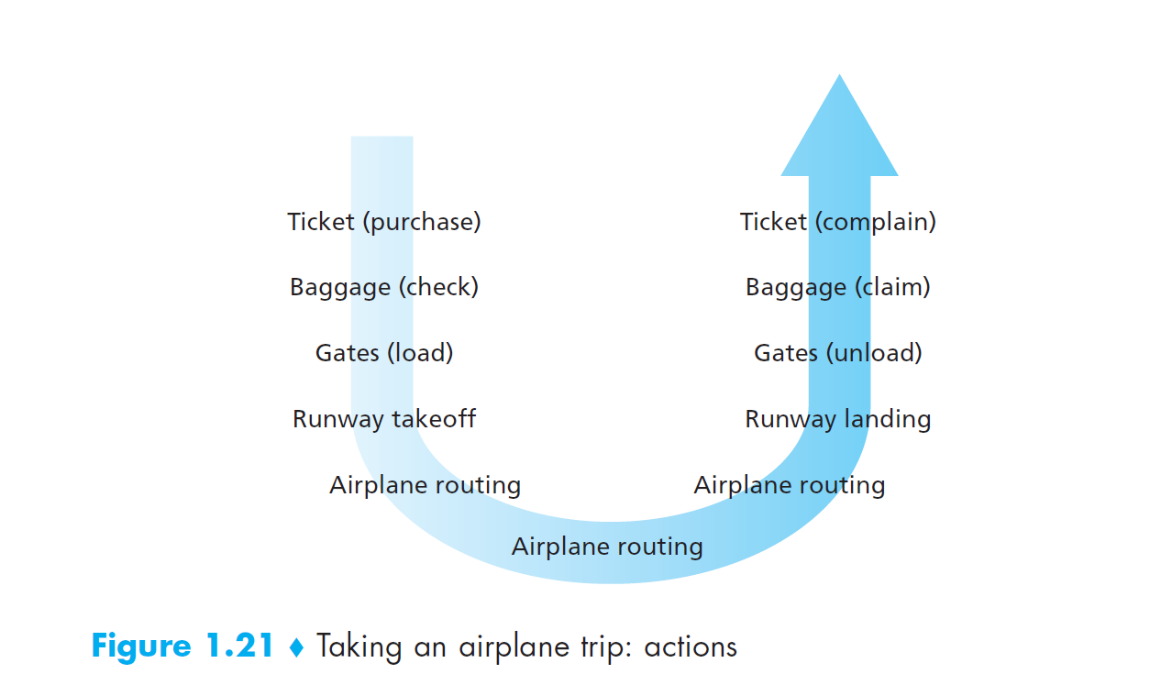

Slide 33
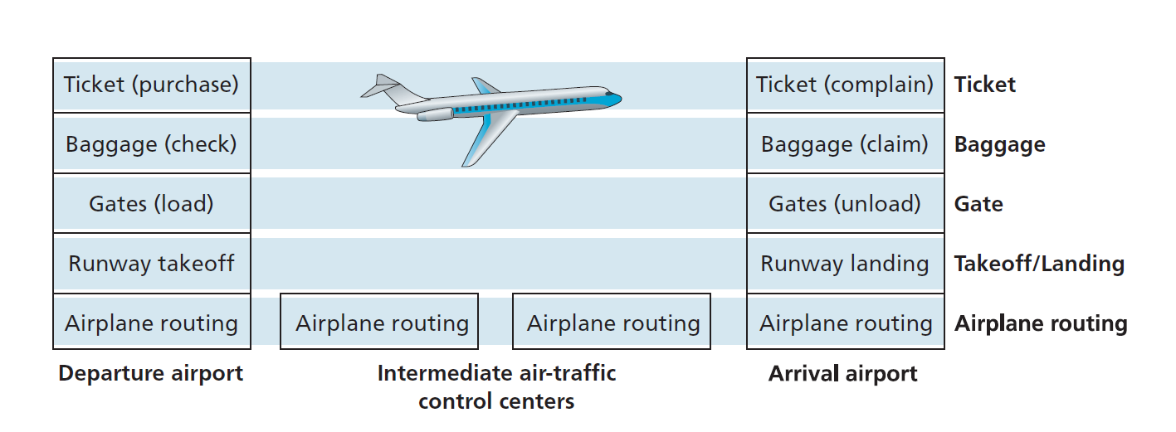

Slide 34
Layered Architecture
The OSI model is composed of seven ordered layers: physical (layer 1), data link (layer 2), network (layer 3), transport (layer 4), session (layer 5), presentation (layer 6), and application (layer 7).
As the message travels from A to B, it may pass through many intermediate nodes.
These intermediate nodes usually involve only the first three layers of the OSI model.
Each layer defines a family of functions distinct from those of the other layers.
Within a single machine, each layer calls upon the services of the layer just below it.
This communication is governed by an agreed-upon series of rules and conventions called protocols.

Slide 35
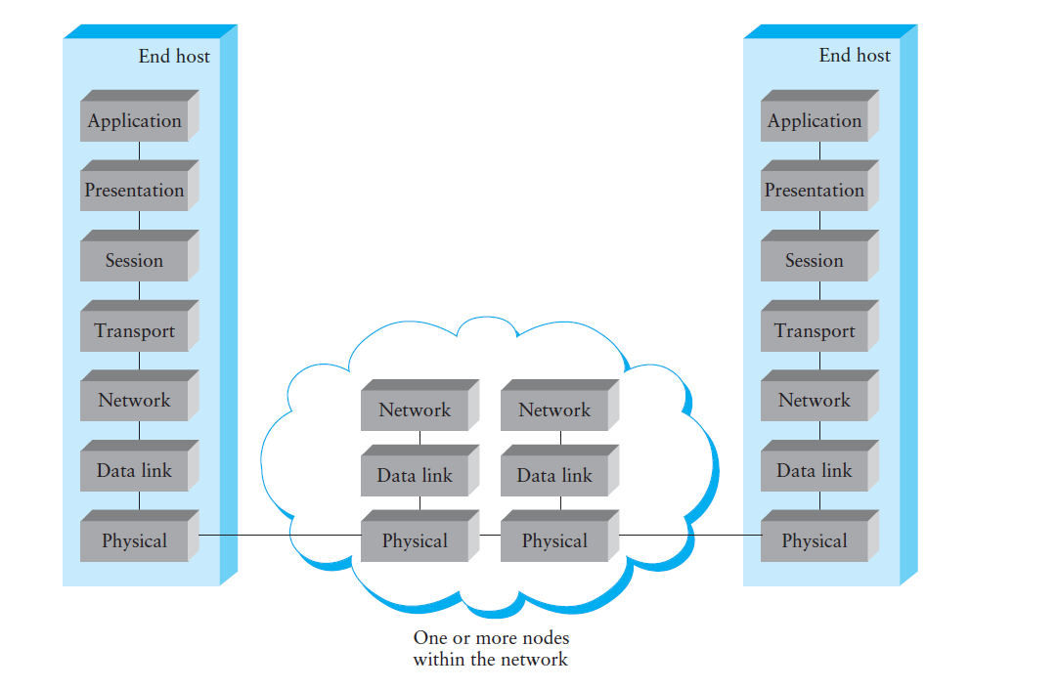

Slide 36
7 Layers of the OSI Model
Layer | Responsible For:
7.) Application | Provides Services to User Apps
6.) Presentation | Data Representation
5.) Session | Communication Between Hosts
4.) Transport | Flow Ctrl, Error Detection/Correction
3.) Network | End to End Delivery, Logical Addr
2.) Data Link | Media Access Ctrl, Physical Addr
1.) Physical | Medium, Interfaces, Puts Bits on Med.

Slide 37
Examples
Layer | Example
7.) Application | HTTP, FTP, SMTP
6.) Presentation | ASCII, JPEG, PGP
5.) Session | BOOTP, NetBIOS, DHCP, DNS
4.) Transport | TCP, UDP, SPX
3.) Network | IP, IPX, ICMP
2.) Data Link | Ethernet, Token Ring, Frame Relay
1.) Physical | Bits, Interfaces, Hubs

Slide 38
Peer to Peer Processes
The processes on each machine that communicate at a given layer are called peer-to-peer processes.
Communication between machines is therefore a peer-to-peer process using the protocols appropriate to a given layer.
Each layer in the sending device adds its own information to the message it receives from the layer just above it and passes the whole package to the layer just below it.
Notes:
Processes interact with the processes at peer layer only

Slide 40
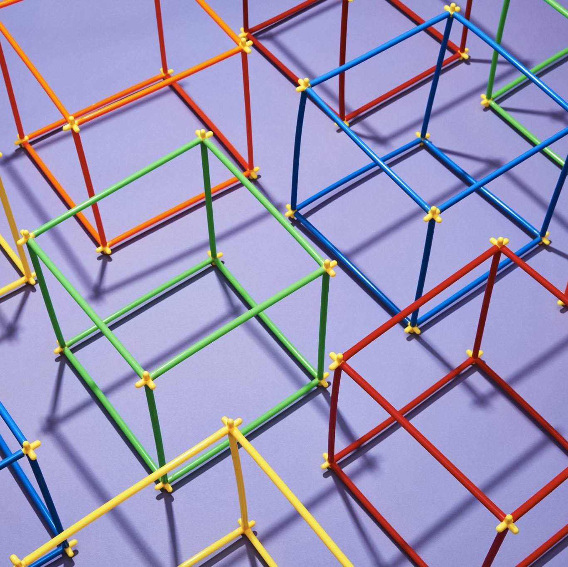
Interfaces between the Layers
The passing of the data and network information down through the layers of the sending device and back up through the layers of the receiving device is made possible
Interface between each pair of adjacent layers.
Defines the information and services a layer must provide for the layer above it.
Well-defined interfaces and layer functions provide modularity to a network.
As long as a layer provides the expected services to the layer above it, the specific implementation of its functions can be modified or replaced without requiring changes to the surrounding layers.

Slide 41
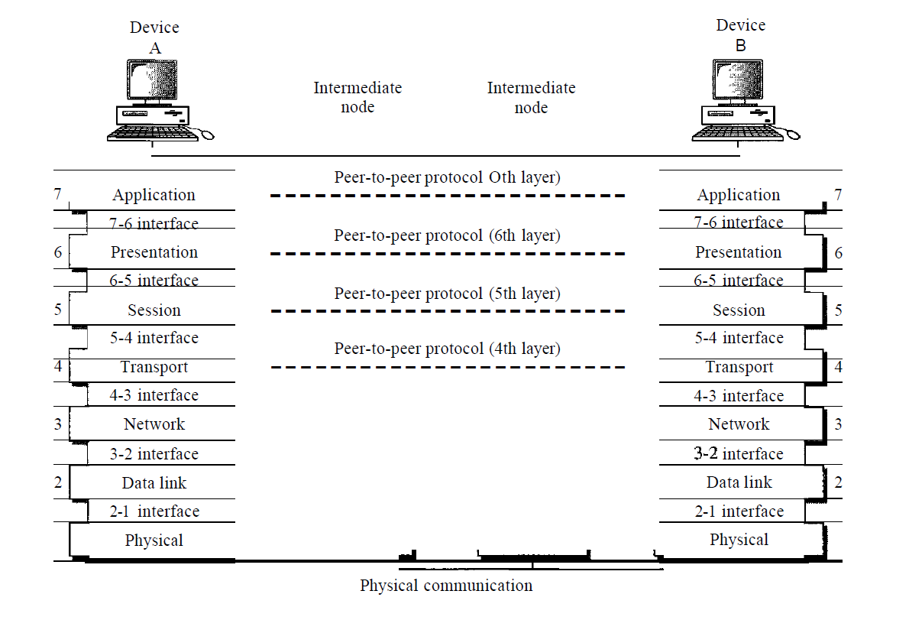

Slide 42
PDU’s And the OSI Model
Layer | PDU Name
7.) Application | Data
6.) Presentation | Data
5.) Session | Data
4.) Transport | Segment
3.) Network | Packet
2.) Data Link | Frame
1.) Physical | Bits
Decapsulation
Encapsulation

Slide 44
Layer 7 – Application Layer
The application layer enables the user, whether human or software, to access the network.
It provides user interfaces and support for services such as electronic mail, remote file access and transfer, shared database management, and other types of distributed information services.
The application layer is responsible for providing services to the user.

Slide 45
Network virtual terminal: A network virtual terminal is a software version of a physical terminal, and it allows a user to log on to a remote host. To do so, the application creates a software emulation of a terminal at the remote host. The user's computer talks to the software terminal which, in turn, talks to the host, and vice versa. The remote host believes it is communicating with one of its own terminals and allows the user to log on.
File transfer, access, and management: This application allows a user to access files in a remote host (to make changes or read data), to retrieve files from a remote computer for use in the local computer, and to manage or control files in a remote computer locally.
Mail services: This application provides the basis for e-mail forwarding and storage.
Directory services: This application provides distributed database sources and access for global information about various objects and services.

Slide 46
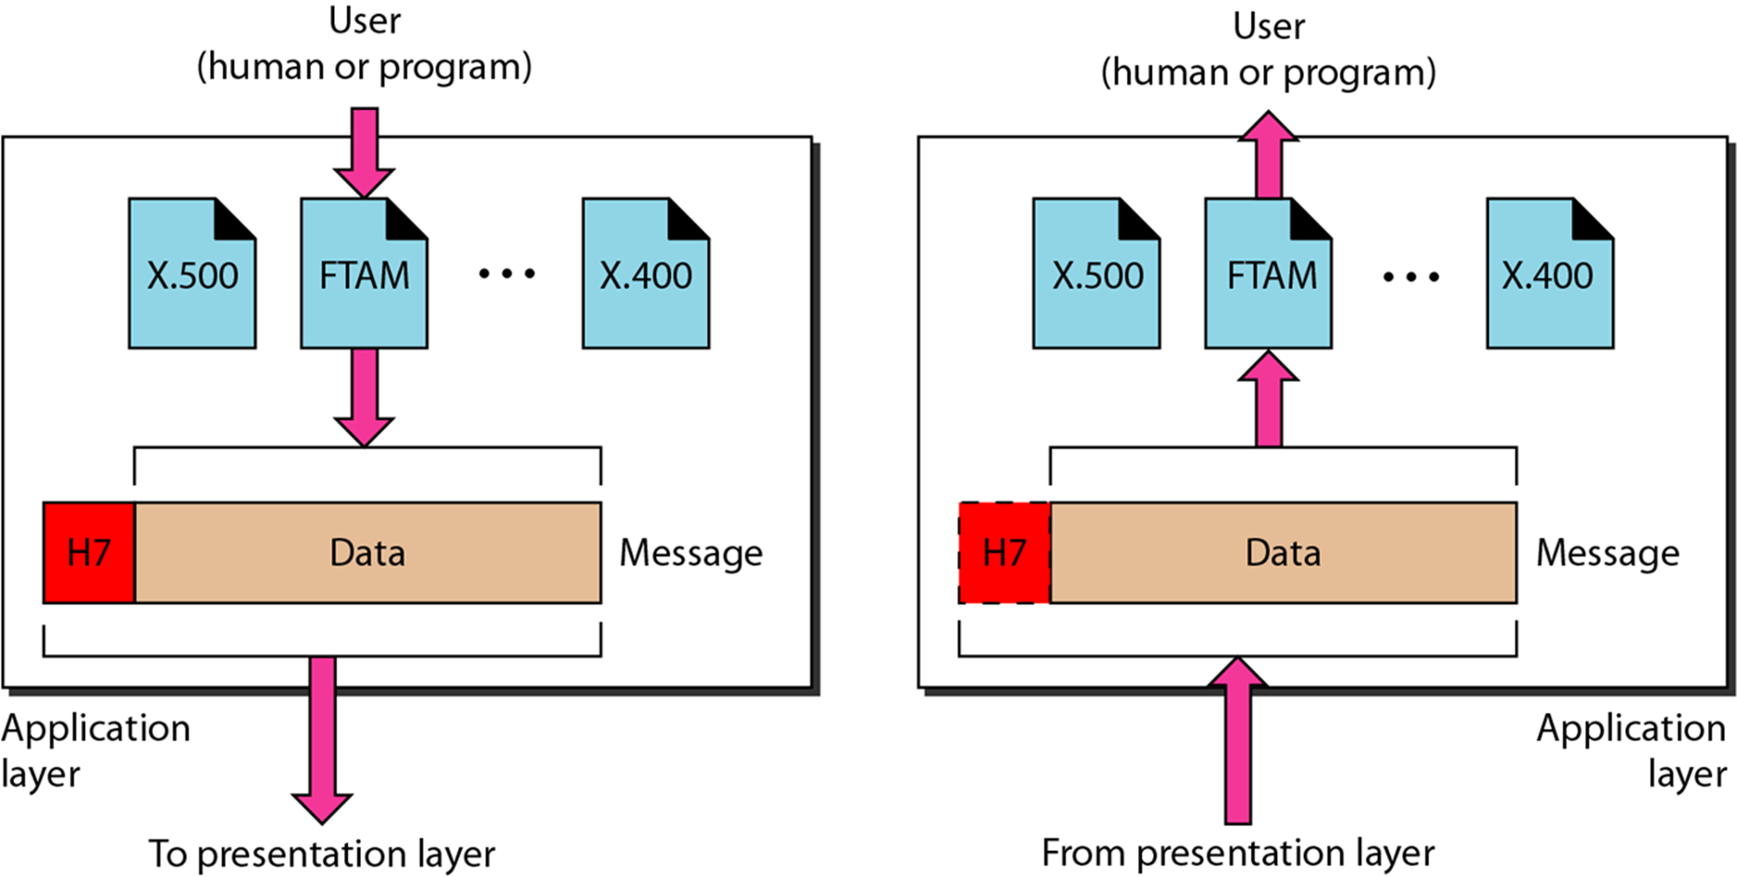
Layer 6 – Presentation Layer
The presentation layer is concerned with the syntax and semantics of the information exchanged between two systems.
Notes:
That’s why data is independent of machine and OS and application versions

Slide 47
Translation: Because different computers use different encoding systems, the presentation layer is responsible for interoperability between these different encoding methods. The presentation layer at the sender changes the information from its sender-dependent format into a common format. The presentation layer at the receiving machine changes the common format into its receiver-dependent format.
Encryption: To carry sensitive information, a system must be able to ensure privacy. Encryption means that the sender transforms the original information to another form and sends the resulting message out over the network. Decryption reverses the original process to transform the message back to its original form.
Compression: Data compression reduces the number of bits contained in the information. Data compression becomes particularly important in the transmission of multimedia such as text, audio, and video.
Notes:
That’s why data is independent of machine and OS and application versions

Slide 48
Layer 5 – Session Layer
The session layer is responsible for dialog control and synchronization.
The session layer is the network dialog controller.
It establishes, maintains, and synchronizes the interaction among communicating systems.

Slide 49
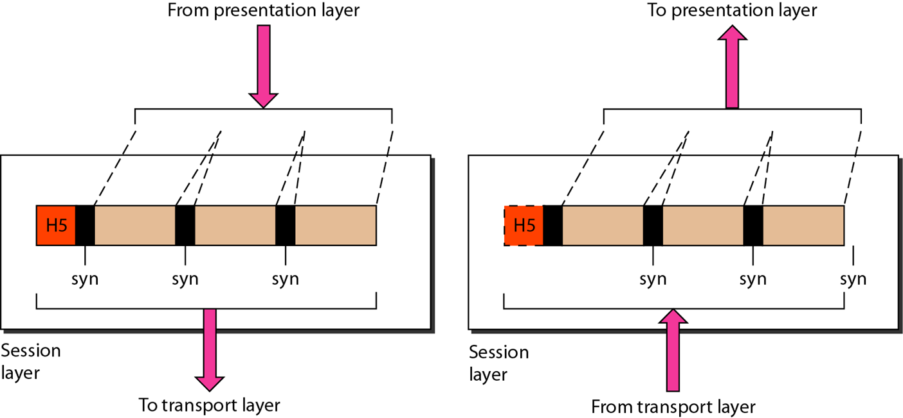

Slide 50
Dialog control: The session layer allows two systems to enter into a dialog. It allows the communication between two processes to take place in either half-duplex (one way at a time) or full-duplex (two ways at a time) mode.
Synchronization: The session layer allows a process to add checkpoints, or synchronization points, to a stream of data. For example, if a system is sending a file of 2000 pages, it is advisable to insert checkpoints after every 100 pages to ensure that each 100-page unit is received and acknowledged independently. In this case, if a crash happens during the transmission of page 523, the only pages that need to be resent after system recovery are pages 501 to 523. Pages previous to 501 need not be resent.

Slide 51
Layer 4 – Transport Layer
The transport layer is responsible for process-to-process delivery of the entire message.
A process is an application program running on a host.
Whereas the network layer oversees source-to-destination delivery of individual packets, it does not recognize any relationship between those packets. It treats each one independently, as though each piece belonged to a separate message, whether or not it does.
The transport layer, on the other hand, ensures that the whole message arrives intact and in order, overseeing both error control and flow control at the source-to-destination level.

Slide 52
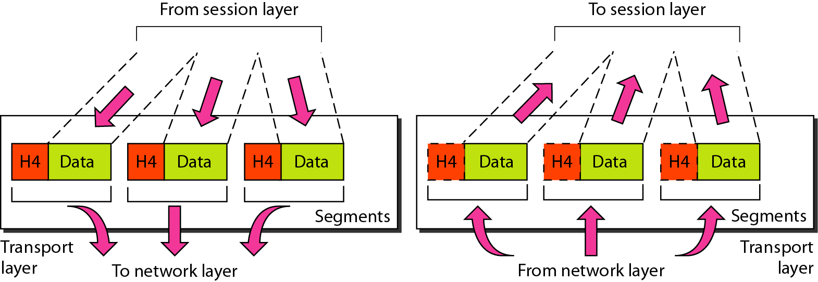

Slide 53
Service-point addressing: Source-to-destination delivery means delivery not only from one computer to the next but also from a specific process (running program) on one computer to a specific process (running program) on the other. The transport layer header must therefore include a type of address called a service-point address (or port address). The network layer gets each packet to the correct computer; the transport layer gets the entire message to the correct process on that computer.
Segmentation and reassembly: A message is divided into transmittable segments, with each segment containing a sequence number. These numbers enable the transport layer to reassemble the message correctly upon arriving at the destination and to identify and replace packets that were lost in transmission.
Connection control: The transport layer can be either connectionless(UDP) or connection oriented(TCP).
Flow control: Like the data link layer, the transport layer is responsible for flow control. However, flow control at this layer is performed end to end rather than across a single link.
Error control: Like the data link layer, the transport layer is responsible for error control. However, error control at this layer is performed process-to-process rather than across a single link. Error correction is usually achieved through retransmission.
Notes:
Connection Control:A connectionless transport layer treats each segment as an independent packet and delivers it to the transport layer at the destination machine. A connection-oriented transport layer makes a connection with the transport layer at the destination machine first before delivering the packets. After all the data are transferred, the connection is terminated.
The sending transport layer makes sure that the entire message arrives at the receiving transport layer without error (damage, loss, or duplication).

Slide 54
Layer 3 – Network Layer
The network layer is responsible for the delivery of individual packets from the source host to the destination host.
If two systems are connected to the same link, there is usually no need for a network layer. However, if the two systems are attached to different networks (links) with connecting devices between the networks (links), there is often a need for the network layer to accomplish source-to-destination delivery.

Slide 55
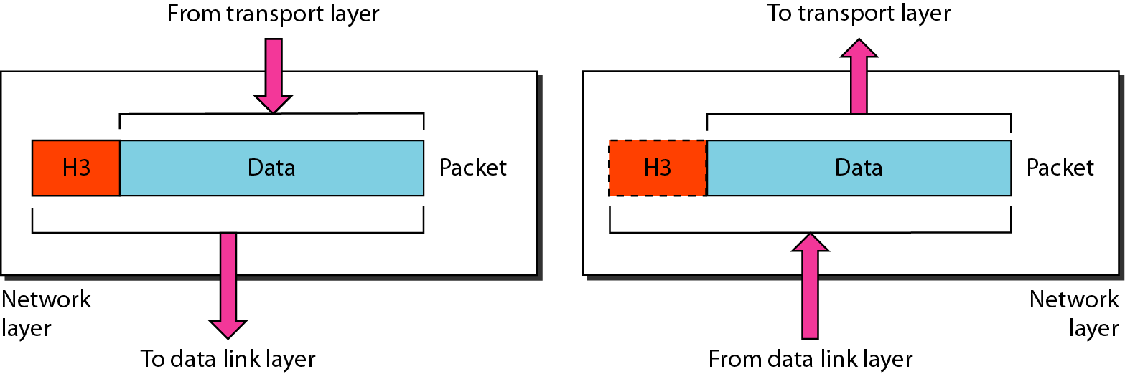

Slide 56
The network Layer controls the operation of the subnet. The main aim of this layer is to deliver packets from source to destination across multiple links (networks). If two computers (system) are connected on the same link, then there is no need for a network layer. It routes the signal through different channels to the other end and acts as a network controller.
It also divides the outgoing messages into packets and to assemble incoming packets into messages for higher levels.
In broadcast networks, the routing problem is simple, so the network layer is often thin or even non-existent.

Slide 57
It translates logical network address into physical address. Concerned with circuit, message or packet switching.
Routers and gateways operate in the network layer. Mechanism is provided by Network Layer for routing the packets to final destination.
Connection services are provided including network layer flow control, network layer error control and packet sequence control.
Breaks larger packets into small packets.
Notes:
NAT: network address translation

Slide 58
Layer 2 – Data Link Layer
The data link layer transforms the physical layer, a raw transmission facility, to a reliable link.
It makes the physical layer appear error free to the upper layer (network layer).
The data link layer is responsible for moving frames from one hop (node) to the next.

Slide 59
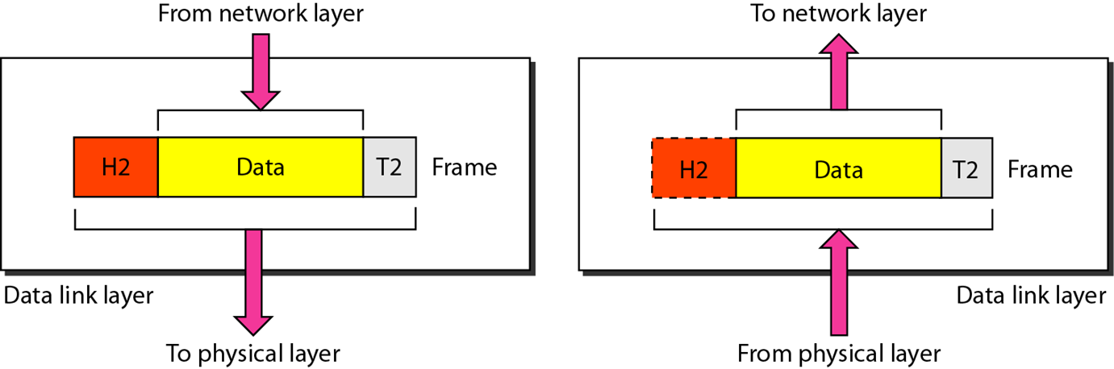

Slide 60
Framing: Divides the stream of bits received from the network layer into manageable data units called frames.
Physical addressing: If frames are to be distributed to different systems on the network, the data link layer adds a header to the frame to define the sender and/or receiver of the frame. If the frame is intended for a system outside the sender’s network, the receiver address is the address of the device that connects the network to the next one.
Flow control: If the rate at which the data are absorbed by the receiver is less than the rate at which data are produced in the sender, the data link layer imposes a flow control mechanism to avoid overwhelming the receiver.
Error control: Adds reliability to the physical layer by adding mechanisms to detect and retransmit damaged or lost frames. Uses a mechanism to recognize duplicate frames. Error control is normally achieved through a trailer added to the end of the frame.
Access control: When two or more devices are connected to the same link, data link layer protocols are necessary to determine which device has control over the link at any given time.

Slide 61
Layer 1 – Physical Layer
Coordinates the functions required to carry a bit stream over a physical medium.
Deals with the mechanical and electrical specifications of the interface and transmission medium.
Also defines the procedures and functions that physical devices and interfaces have to perform for transmission to occur.
Provides services to the upper layer(data link layer).
The physical layer is responsible for movements of individual bits from one hop (node) to the next.

Slide 62
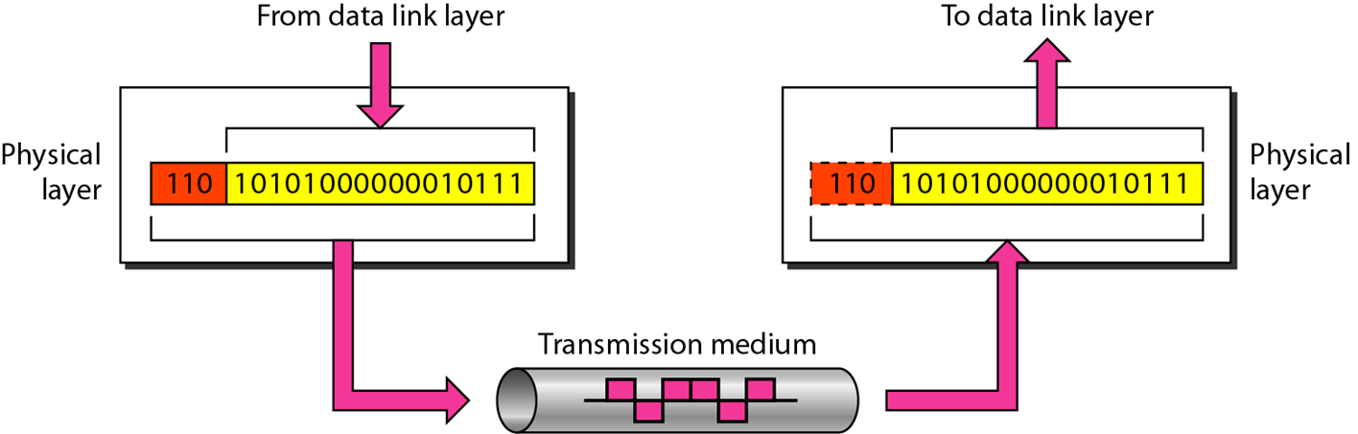

Slide 63
Physical characteristics of interfaces and medium: Interface between the devices and the transmission medium. It also defines the type of transmission medium.
Representation of bits: The physical layer data consists of a stream of bits sequence of (0s or 1s) with no interpretation. To be transmitted, bits must be encoded into signals--electrical or optical. Defines the type of encoding.
Data rate: The transmission rate-the number of bits sent each second.
Synchronization of bits: The sender and receiver not only must use the same bit rate but also must be synchronized at the bit level. In other words, the sender and the receiver clocks must be synchronized.
Line configuration: concerned with the connection of devices to the media (point-to-point, multipoint).
Physical topology: The physical topology defines how devices are connected to make a network. mesh topology, a star topology , a ring topology, a bus topology or a hybrid topology.
Transmission mode: The physical layer also defines the direction of transmission between two devices: simplex, half-duplex, or full-duplex.

Slide 64
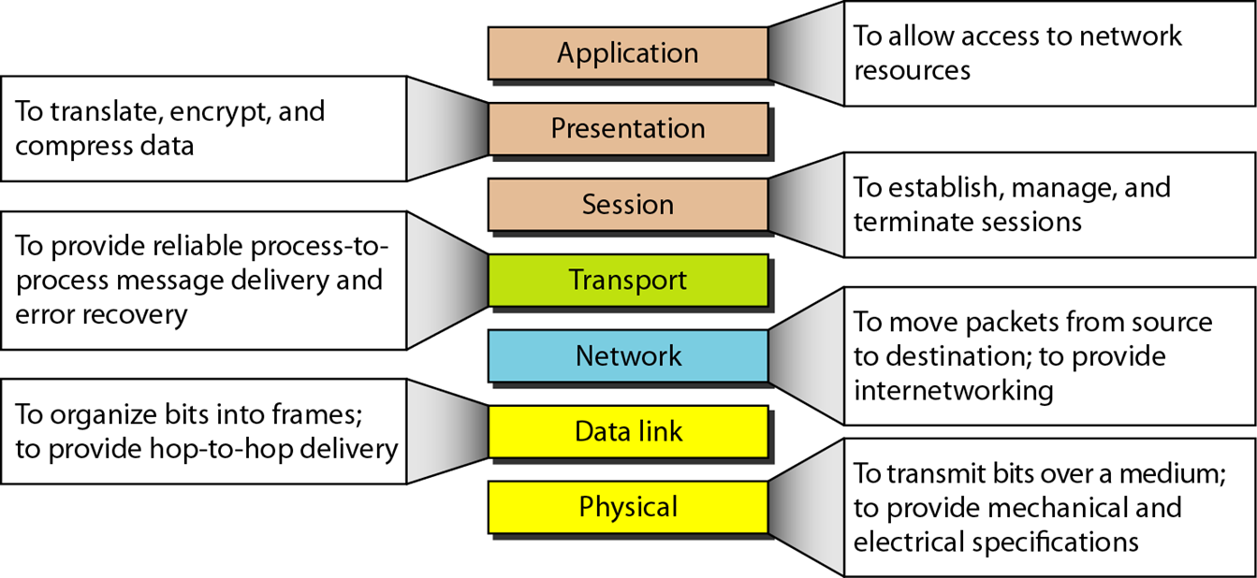

Slide 65
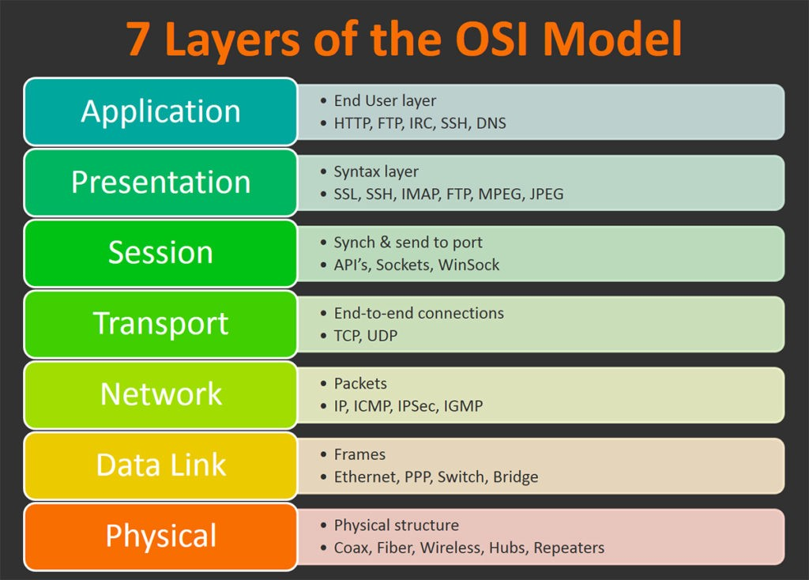

Slide 66
PDU’s And the OSI Model
Layer | PDU Name
7.) Application | Data
6.) Presentation | Data
5.) Session | Data
4.) Transport | Segment
3.) Network | Packet
2.) Data Link | Frame
1.) Physical | Bits
Decapsulation
Encapsulation

Slide 68
TCP/IP Protocol Suite
The layers in the TCP/IP protocol suite do not exactly match those in the OSI model.
The original TCP/IP protocol suite was defined as having four layers: host-to-network, internet, transport, and application.
However, when TCP/IP is compared to OSI, we can say that the TCP/IP protocol suite is made of five layers:
physical,
data link,
network,
transport, and
application.

Slide 69
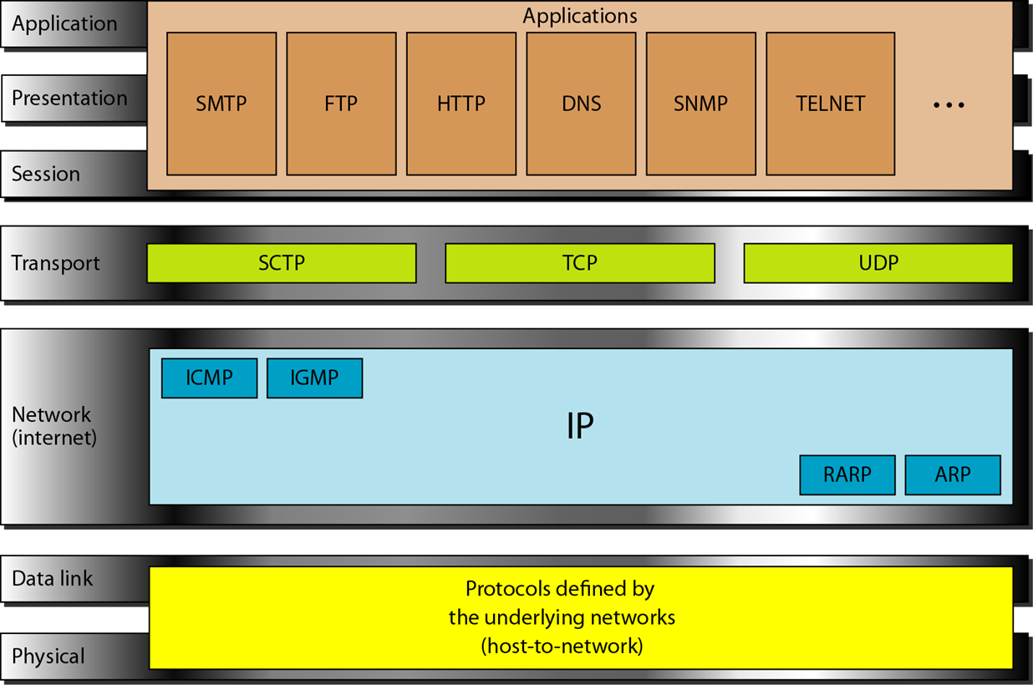

Slide 70
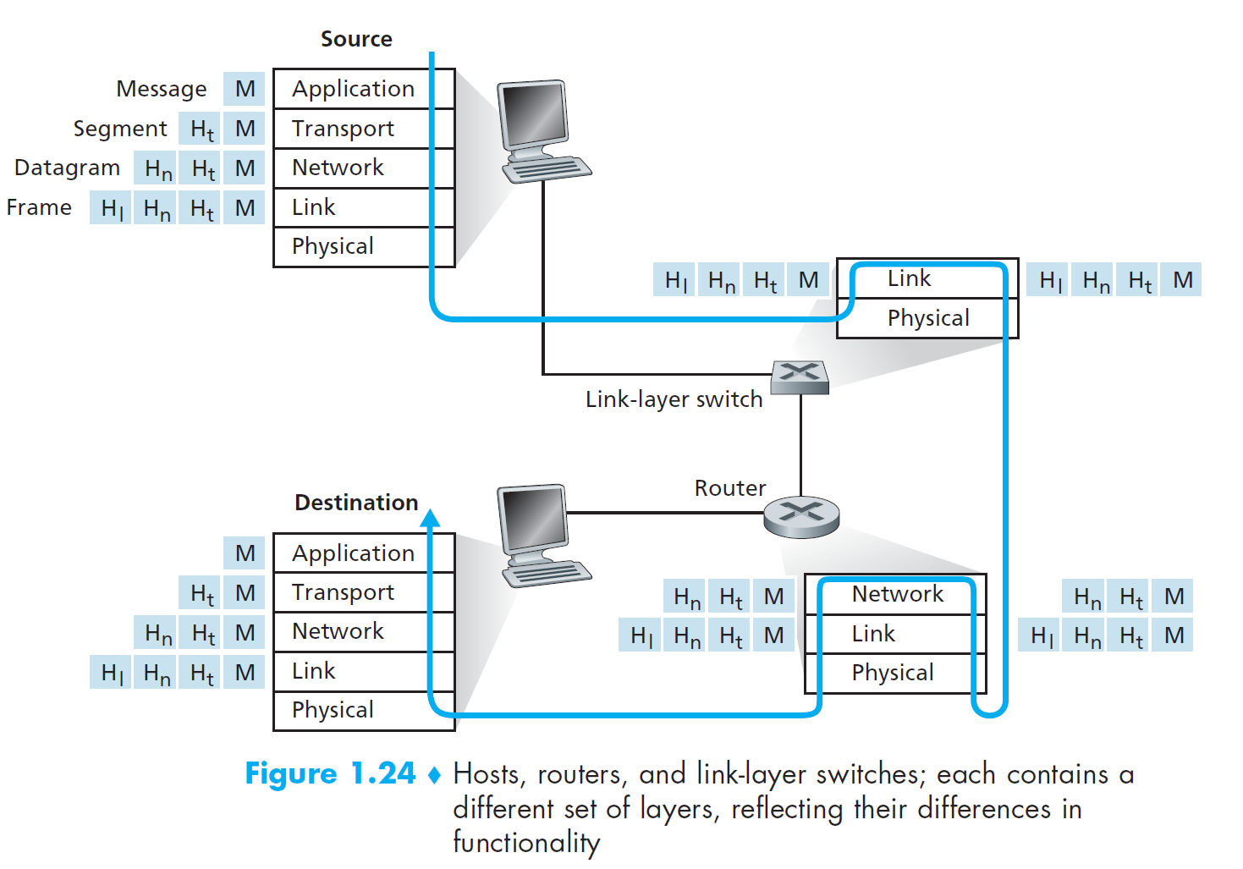

Slide 71
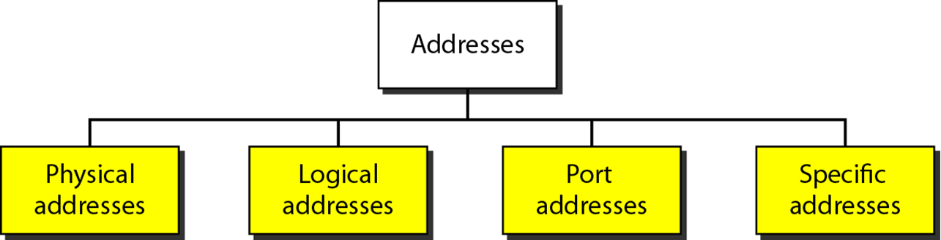
Addressing
Four levels of addresses are used in an internet employing the TCP/IP protocols:
physical (link) addresses,
logical (IP) addresses,
port addresses, and
specific addresses

Slide 72
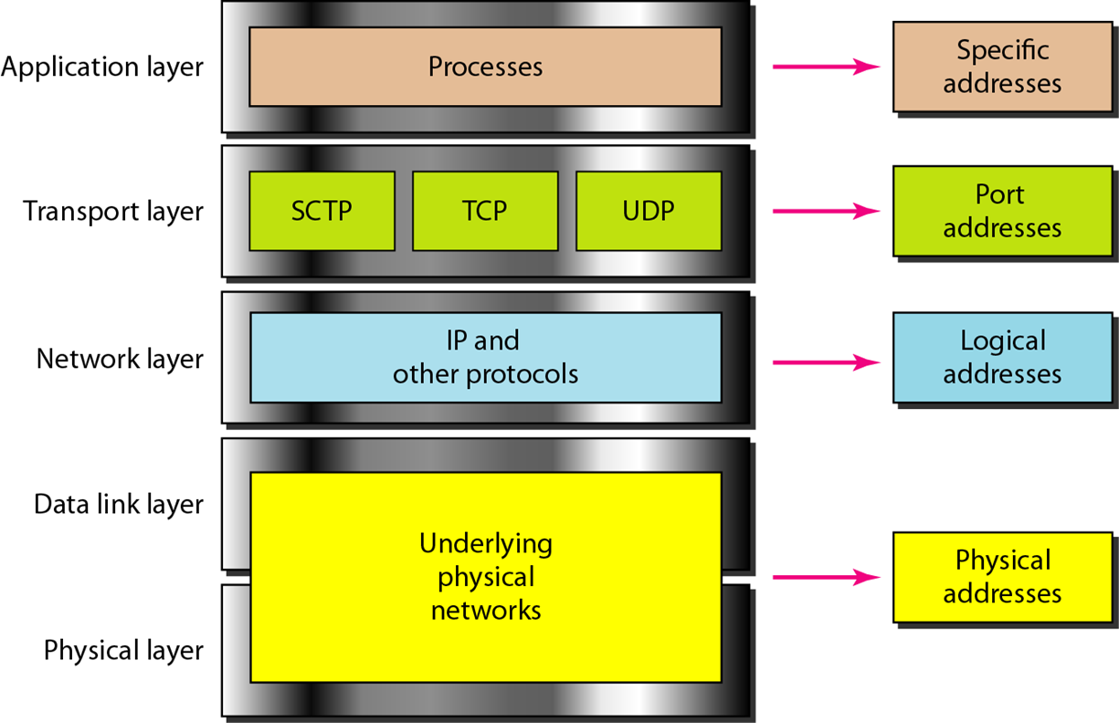
Notes:
Logical Address= IP Address
Physical Address= MAC address

Slide 73
Reading Assignment
Comparison between OSI and TCP/IP model.
Addresses and its types.
Different Addresses for different applications and networks.
Cmd-> ipconfig/all
Notes:
IP addresses changes with the change in network or sometimes after reconnecting or after a longer duration of time

Slide 74
References
https://www.computernetworkingnotes.com/networking-tutorials/network-cable-types-and-specifications.html
Data Communication and Computer Networks by Behrouz A Forouzan.pdf
Data And Computer Communications by William Stallings.pdf
https://www.academia.edu/37562829/INTRODUCTION_TO_COMPUTER_NETWORKS
https://www.studytonight.com/computer-networks/osi-model-network-layer#:~:text=Network%20Layer%20%2D%20OSI%20Model,across%20multiple%20links%20(networks).&text=It%20routes%20the%20signal%20through,acts%20as%20a%20network%20controller.
https://www.guru99.com/difference-tcp-ip-vs-osi-model.html#:~:text=OSI%20refers%20to%20Open%20Systems,both%20connection%2Doriented%20and%20connectionless.

